Slide 1
Shapley Values
Use Game Theory (Monte Carlo Simulations) to gain Explainability on Machine Learning Models
For each feature value in each observation the marginal contribution is calculated
Regulators like the European Central Bank and Bank of England deem Shapley Values to lighten up the Black Box enough to make an approval for financial applications highly probable

Slide 2
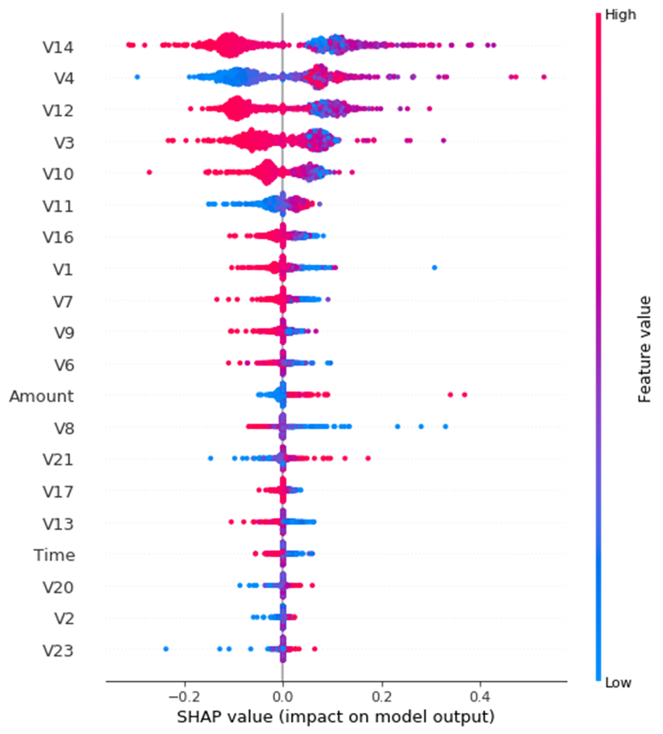
Shapley Values for a logistic regression applied to the under sampled dataset (equal number of fraudulent and non-fraudulent transactions
Feature 14 has the most impact on the prediction
Note that higher and lower feature values do not necessarily have an linear impact on the prediction but have to be judged depending on the whole observation

